Slide 1
Speaking with your Desktop
Raphael N. Motta
Nickolay V. Shmyrev

Slide 2
Speech Recognition
Speech Recognition, also know as ASR – Automatic Speech Recognition or Computer Speech Recognition is the conversion of spoken text in readable text.
Application using Speech Recognition
  Voice Dialing
  Interactive Voice Response - IVR
  Robotic
  Interface with Computers
  Others
Speech Recognition System Components
  Recognizer
  Dictionary
  Acoustic models
  Grammars

Slide 3
Speech Recognition
Recent Performance
  10 words (99%)
  5000 words (90%)
  60000 words (70%)
  More than 1000000 words (unknow)
Methods to improve the Speech Recognition
  Speaker Clustering
  Online Adaptation
  Language Models
  Confidence Measures
  Noise Cancelation

Slide 4
Voice Interfaces
Slow response time (3-4 sec.)
Importance of understanding
  60% correctly recognized words without Language Models
  90% correctly recognized words with Language Models
Fast input
  Typing, 50 – 70 words per minute
  Speaking, 200 – 300 words per minute
Natural Interface

Slide 5
Voice Control Software
Engines:
  PocketSphinks
  Julius
Training Tools
  SphinxTrain
  HTK
Dialog Managers
  Xvoice
  GNOME-Voice-Control
  Simon
  Perlbox
IVR
  Asterisk (obsolete)
  FreeSwitch

Slide 6
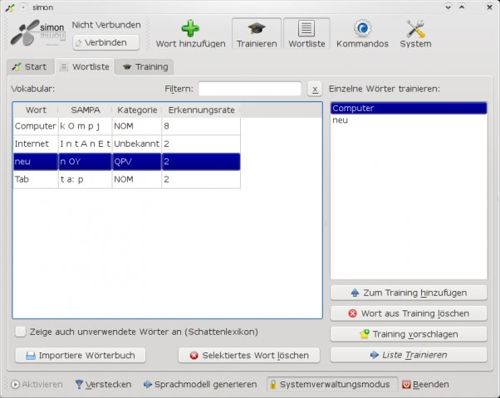
Screenshot of Simon

Slide 7
GNOME-Voice-Control
Languages
  English
  German
  Russian
  Spanish
Frameworks
  Ally
  Gstreamer
  PocketSphinx
Confidence

Slide 8
Demonstration of
GNOME-Voice-Control

Slide 9
Understanding

Slide 10
Multimodal Interfaces
Interaction with
  Vision Recognition
  Speech Recognition
  Traditional Input

Slide 11
VoxForge
What is VoxForge?
  GPL License
  Near target – 140 Hours of Speech
  Current State
    50 Hours of English
    10 Hours of German
    10 Hours of Russian
  Models used in GNOME-Voice-Control
    Russian
    German
  Models need work
    Processing
    Cleaning

Slide 12
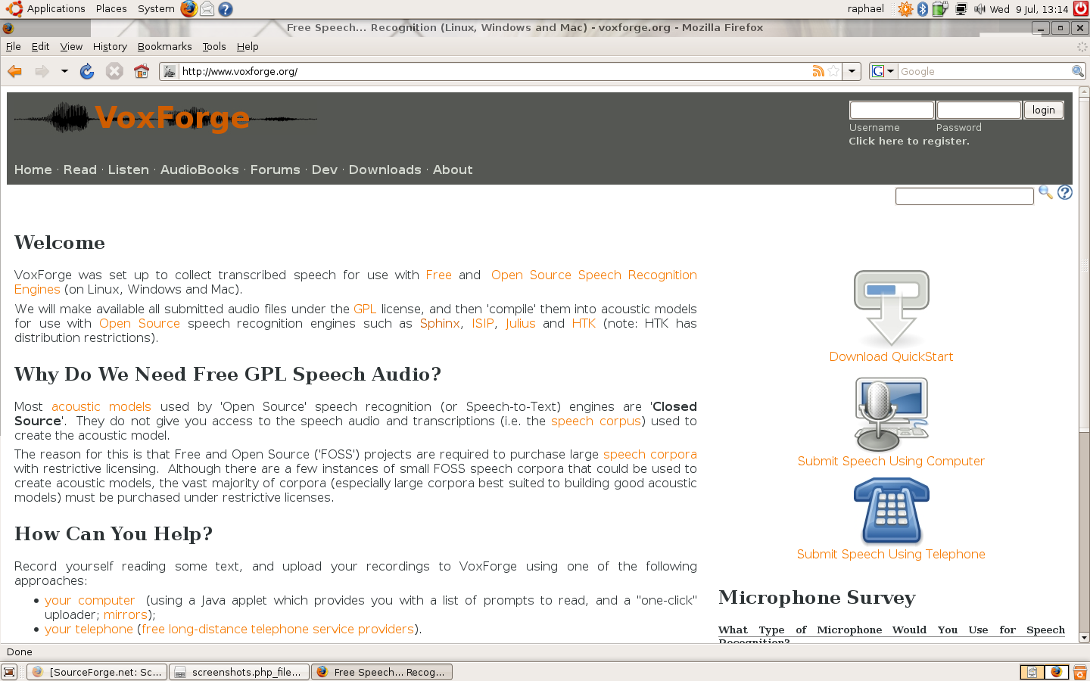
VoxForge

Slide 13
VoxForge
How to Help?
  Submitting your voice
    Applet
    FTP
  Maintaining the language database

Slide 14
TTS Bases
High quality engines
  Festival
  OpenMary
We need high quality TTS Bases
What do I need
  Dictionary or LTS Rules (They actually exist in espeak TTS)
  Recorded Speech which split by utterances and transcribed (about 4 hours)

Slide 15
Conclusions
People are saying that ASR doesn't work
Marketing people say it works perfectly
Actually it's just work in progress

Slide 16
Questions????

